Slide 1
RUP-Workflows
Behtash Moradi
Moradi_behtash@hotmail.com

Slide 2
Planning Phases
All phases are not identical in terms of schedule and effort. Although this varies considerably depending on the project,
A typical initial development cycle for a medium-sized project should anticipate the following distribution between effort and schedule (Next Slide)

Slide 3
Effort and Schedule
 | Inception | Elaboration | Construction | Transition
Effort | ~5 % | 20 % | 65 % | 10%
Schedule | 10 % | 30 % | 50 % | 10%

Slide 4
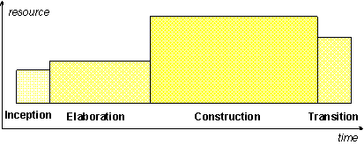
Resources and Times

Slide 5
ِDevelopment Cycle
One pass through the four phases is a development cycle;
ٍEach pass through the four phases produces a generation of the software. Unless the product "dies," it will evolve into its next generation by repeating the same sequence of inception, elaboration, construction and transition phases, but this time with a different emphasis on the various phases. These subsequent cycles are called evolution cycles. As the product goes through several cycles, new generations are produced.

Slide 6
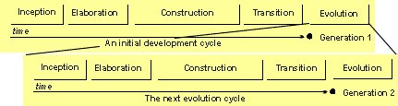
development cycle -Continue

Slide 7
Phase: Inception
The overriding goal of the inception phase is to achieve concurrence among all stakeholders on the lifecycle objectives for the project.
The inception phase is of significance primarily for new development efforts, in which there are significant business and requirements risks which must be addressed before the project can proceed. For projects focused on enhancements to an existing system, the inception phase is more brief, but is still focused on ensuring that the project is both worth doing and possible to do.

Slide 8
Primary Objectives of the Inception Phase
Establishing the project's software scope and boundary conditions, including an operational vision, acceptance criteria and what is intended to be in the product and what is not.
Discriminating the critical use cases of the system, the primary scenarios of operation that will drive the major design trade-offs.
Exhibiting, and maybe demonstrating, at least one candidate architecture against some of the primary scenarios
Estimating the overall cost and schedule for the entire project (and more detailed estimates for the elaboration phase that will immediately follow)
Estimating potential risks (the sources of unpredictability) (See Concepts: Risk)
Preparing the supporting environment for the project.

Slide 9
Inception -Essential activities
Formulating the scope of the project. This involves capturing the context and the most important requirements and constraints to such an extent that you can derive acceptance criteria for the end product.
Planning and preparing a business case. Evaluating alternatives for risk management, staffing, project plan, and cost/schedule/profitability trade-offs.
Synthesizing a candidate architecture, evaluating trade-offs in design, and in make/buy/reuse, so that cost, schedule and resources can be estimated. The aim here is to demonstrate feasibility through some kind of proof of concept. This may take the form of a model which simulates what is required, or an initial prototype which explores what are considered to be the areas of high risk. The prototyping effort during inception should be limited to gaining confidence that a solution is possible - the solution is realized during elaboration and construction.
Preparing the environment for the project, assessing the project and the organization, selecting tools, deciding which parts of the process to improve.

Slide 10
Phase: Elaboration
The goal of the elaboration phase is to baseline the architecture of the system to provide a stable basis for the bulk of the design and implementation effort in the construction phase. The architecture evolves out of a consideration of the most significant requirements (those that have a great impact on the architecture of the system) and an assessment of risk. The stability of the architecture is evaluated through one or more architectural prototypes

Slide 11
Primary Objectives of The Elaboration Phase
To ensure that the architecture, requirements and plans are stable enough, and the risks sufficiently mitigated to be able to predictably determine the cost and schedule for the completion of the development. For most projects, passing this milestone also corresponds to the transition from a light-and-fast, low-risk operation to a high cost, high risk operation with substantial organizational inertia.
To address all architecturally significant risks of the project
To establish a baselined architecture derived from addressing the architecturally significant scenarios, which typically expose the top technical risks of the project.
To produce an evolutionary prototype of production-quality components, as well as possibly one or more exploratory, throw-away prototypes to mitigate specific risks such as:
  design/requirements trade-offs
  component reuse
  product feasibility or demonstrations to investors, customers, and end-users.
To demonstrate that the baselined architecture will support the requirements of the system at a reasonable cost and in a reasonable time.
To establish a supporting environment.

Slide 12
Elaboration -Essential activities
Defining, validating and baselining the architecture as rapidly as practical.
Refining the Vision, based on new information obtained during the phase, establishing a solid understanding of the most critical use cases that drive the architectural and planning decisions.
Creating and baselining detailed iteration plans for the construction phase.
Refining the development case and putting in place the development environment, including the process, tools and automation support required to support the construction team.
Refining the architecture and selecting components. Potential components are evaluated and the make/buy/reuse decisions sufficiently understood to determine the construction phase cost and schedule with confidence. The selected architectural components are integrated and assessed against the primary scenarios. Lessons learned from these activities may well result in a redesign of the architecture, taking into consideration alternative designs or reconsideration of the requirements.

Slide 13
Phase: Construction
The goal of the construction phase is on clarifying the remaining requirements and completing the development of the system based upon the baselined architecture.
The construction phase is in some sense a manufacturing process, where emphasis is placed on managing resources and controlling operations to optimize costs, schedules, and quality. In this sense the management mindset undergoes a transition from the development of intellectual property during inception and elaboration, to the development of deployable products during construction and transition.

Slide 14
Primary Objectives of The Construction Phase
Minimizing development costs by optimizing resources and avoiding unnecessary scrap and rework.
Achieving adequate quality as rapidly as practical
Achieving useful versions (alpha, beta, and other test releases) as rapidly as practical
Completing the analysis, design, development and testing of all required functionality.
To iteratively and incrementally develop a complete product that is ready to transition to its user community. This implies describing the remaining use cases and other requirements, fleshing out the design, completing the implementation, and testing the software.
To decide if the software, the sites, and the users are all ready for the application to be deployed.
To achieve some degree of parallelism in the work of development teams. Even on smaller projects, there are typically components that can be developed independently of one another, allowing for natural parallelism between teams (resources permitting). This parallelism can accelerate the development activities significantly; but it also increases the complexity of resource management and workflow synchronization. A robust architecture is essential if any significant parallelism is to be achieved.

Slide 15
Construction -Essential Activities
Resource management, control and process optimization
Complete component development and testing against the defined evaluation criteria
Assessment of product releases against acceptance criteria for the vision.

Slide 16
Phase: Transition
The focus of the Transition Phase is to ensure that software is available for its end users. The Transition Phase can span several iterations, and includes testing the product in preparation for release, and making minor adjustments based on user feedback. At this point in the lifecycle, user feedback should focus mainly on fine tuning the product, configuring, installing and usability issues, all the major structural issues should have been worked out much earlier in the project lifecycle.
By the end of the Transition Phase lifecycle objectives should have been met and the project should be in a position to be closed out. In some cases, the end of the current life cycle may coincide with the start of another lifecycle on the same product, leading to the next generation or version of the product. For other projects, the end of Transition may coincide with a complete delivery of the artifacts to a third party who may be responsible for operations, maintenance and enhancements of the delivered system.

Slide 17
Primary Objectives of The Transition
beta testing to validate the new system against user expectations
beta testing and parallel operation relative to a legacy system that it's replacing
converting operational databases
training of users and maintainers
roll-out to the marketing, distribution and sales forces
deployment-specific engineering such as cutover, commercial packaging and production, sales roll-out, field personnel training
tuning activities such as bug fixing, enhancement for performance and usability
assessment of the deployment baselines against the complete vision and the acceptance criteria for the product
achieving user self-supportability
achieving stakeholder concurrence that deployment baselines are complete
achieving stakeholder concurrence that deployment baselines are consistent with the evaluation criteria of the vision

Slide 18
Transition -Essential activities
ٍExecuting deployment plans
Finalizing end-user support material
Testing the deliverable product at the development site
Creating a product release
Getting user feedback
Fine-tuning the product based on feedback
Making the product available to end users

Slide 19
Start up: Outline the iteration plan, risks, and architectural objectives
The Worker: Project Manager starts by sketching a an Artifact: Iteration Plan for the current iteration, based on the outlined Artifact: Software Development Plan during the Initial Iteration in Inception.
Evaluation criteria for the architecture are outlined by the Worker: Architect in the Artifact: Software Architecture Document, taking into consideration the "architectural risks" that are to be mitigated (see Artifact: Risk List).
Remember that one of the goals of Elaboration is establishing a robust, executable architecture; the plan for doing this needs to be developed in the initial Elaboration iteration.

Slide 20
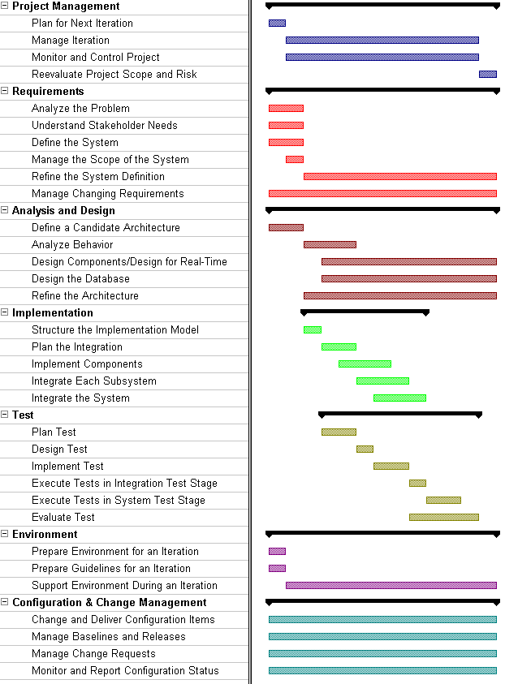
Iteration Plan-E1

Slide 21
Requirements: Decide what will "drive" the development of the architecture
The Worker: Architect and the Worker: Project Manager then determine which use cases and/or scenarios should be addressed in the current iteration; these use cases and/or scenarios drive the development of the architecture (see Workflow Detail: Manage Scope of the System in the Requirements Workflow). The Artifact: Iteration Plan created in previous step should be updated accordingly

Slide 22
Use-Case Analysis
Find Use Case and Actors
Find obvious classes, do an initial (high-level) subsystem partitioning, and start looking at the "drivers" in detail.

Slide 23
Understand the "drivers" in detail, if necessary; inspect results.
A number of Worker: Use-Case Specifiers then describe in detail the architecturally significant subsets of the selected use cases/scenarios (see Workflow Detail: Refine the System Definition in the Requirements workflow). As the model evolves, the Worker: System Analyst may restructure the Artifact: Use-Case Model to improve the comprehensibility of the model. The changes to the Artifact: Use-Case Model are then reviewed and approved (see Workflow Detail: Manage Changing Requirements in the Requirements Workflow)

Slide 24
َArchitecture are reconsidered; risks also need to be reconsidered.
The use-case view is revisited again by the Worker: Architect, taking into consideration new use-case descriptions, and possibly a new structure of the Artifact: Use-Case Model (revisit Workflow Detail: Manage Scope of the System in the Requirements Workflow). The task now is to select what set of use cases and/or scenarios should be analyzed, designed and implemented in the current iteration. Note again that the development of these use cases and/or scenarios set the software architecture. The Worker: Project Manager again updates the current iteration plan accordingly (see Artifact: Iteration Plan), and might also reconsider risk management, because new risks might have been made visible according to new information (see Artifact: Risk List).

Slide 25
Architect Responsibilities in Analysis and Design
To get a general feeling of the obvious classes needed, the Worker: Architect then considers the system requirements, the glossary, the use-case view (but not use case descriptions), and the team's general domain knowledge to sketch the outline of the subsystems, possibly in a layered fashion (see Activity: Identify Design Elements in the Analysis & Design Workflow).
The analysis mechanisms (common solutions to frequent analysis problems) are also identified by the architect.
In parallel with this effort, a team of Worker: Designers, possibly together with the architect, will start finding Artifact: Analysis Classes for this iteration's use cases and/or scenarios, as well as beginning to allocate responsibilities to the identified classes and analysis mechanisms.
The designers will use the obvious classes found by the architect as input. Then, a number of designers refine the classes identified in the previous step by allocating responsibilities to the classes, and updating their relationships and attributes. It is determined in detail how the available analysis mechanisms are used by each class. When this is done, the Worker: Architect identifies a number of classes that should be considered as architecturally significant, and includes these classes in the logical view section of the Artifact: Software Architecture Document. The resulting analysis artifacts are then reviewed.

Slide 26
Design:
Adjust to the implementation ٍEnvironment, decide how the "drivers" are to be designed,
Refine the definition of classes, packages and subsystems; inspect results.

Slide 27
The Worker: Architect then refines the architecture by deriving the design mechanisms (e.g. programming language, database, distribution mechanism, communication mechanism) needed by the earlier identified analysis mechanisms (see Activity: Identify Design Mechanisms in the Analysis & Design Workflow).
Artifact: Design Subsystems are defined and design classes are allocated to them; the interfaces to subsystems are identified. Remaining design classes are partitioned into packages, and responsibilities for subsystems and packages are allocated to Worker: Designers.
Instances of classes and subsystems are used by designers to describe the realizations of the selected use cases and/or scenarios (see Workflow Detail: Design Components in the Analysis & Design workflow). This puts requirements on the employed model elements and their associated design mechanisms; in the process the interaction diagrams previously created are refined. The requirements put on each design mechanism are handled by the architect (revisit Activity Identify Design Mechanisms in the Analysis & Design workflow). The logical view is updated accordingly by the architect. The resulting design artifacts are then reviewed.

Slide 28
Consider the concurrency and distribution aspect of the architecture.
The next step for the architect is to consider the concurrency and distribution required by the system. This is done by studying the tasks and processes required and the physical network of processors and other devices (see Activity: Describe the Run-time Architecture and Activity: Describe Distribution in the Analysis & Design Workflow).
An important input to the architect here are the designed use cases in terms of collaborating objects in interaction diagrams; these objects are allocated to tasks and processes, which in turn are allocated to processors and other devices. This results in both a logical and physical distribution of functionality.

Slide 29
Inspect the architecture.
The architecture is reviewed. See Activity: Review the Architecture

Slide 30
Implementation: Consider the physical packaging of the architecture
An Worker: Architect now considers the impact of the architectural design onto the implementation model,
Defines the initial structure of the implementation model (revisit Activity: Structure the Implementation Model in the Analysis & Design workflow).

Slide 31
Implementation: Implement the classes and integrate
A number of implementers now implement and unit test the classes identified in the architectural design (Step 5, 6, and 7).
The implementations of the classes are physically packaged into components and subsystems in the implementation model.
The implementers also fix defects (see Workflow Detail: Implement Classes Within an Iteration in the Implementation workflow).
The testers integration test the implementation subsystem (see Workflow Detail: Execute Integration Test in the Test workflow),
and then the implementers release the tested implementation subsystems to system integration.

Slide 32
Implementation: Plan the integration
A system integrator now studies the use cases that are to be implemented in this iteration,
and defines the order in which subsystems should be implemented, and later integrated into an architectural prototype (see Workflow Detail: Plan the Integration within an Iteration in the Implementation workflow).
The results of this planning should be reflected in the Artifact: Software Development Plan.

Slide 33
Integrate the implemented parts
The system integrators incrementally integrate the subsystems into an executable architectural prototype (see Workflow Detail: Integrate the System within an Iteration in the Implementation workflow).
Each build is tested (see Workflow Detail: Execute Integration Test in the Test workflow).

Slide 34
Test: Plan integration tests and system tests.
A test designer now plans the system tests and the integration tests.
Selects measurable testing goals to be used when assessing the architecture. These goals could be expressed in terms of being able to execute a use-case scenario, with a certain response time, or response time under specified load.
The test designer also identifies and implements test cases and test procedures. (See Workflow Detail: Plan and Design Test and Workflow Detail: Plan and Design System Test in the Test workflow.)

Slide 35
Test: Assess the executable architecture
Once the whole system (as defined by the goal of this iteration) has been integrated, the system tester tests the system (see Workflow Detail: Execute System Test in the Test workflow).
The test designer then analyzes the results of the test to make sure the testing goals have been reached (see Workflow Detail: Evaluate System Test in the Test workflow).
The Worker: Architect will then assess this result and compare it with the risk initially identified.

Slide 36
Environment: Prepare environment for the iteration
The Worker: Process Engineer and the Worker: Tool Specialist prepare the environment for the iteration (see the Workflow Detail: Prepare Environment for an Iteration).
An important input is the evaluation of the previous iteration.
The Worker: Process Engineer completes the Artifact: Development Case and tailor templates (see Artifact: Project-Specific Templates), to be ready for the iteration, by tailoring (at least) the Analysis & Design workflow and the Implementation workflow.
The Worker: Tool Specialist sets up the tools (see Artifact: Tools) to be used in the iteration. If necessary, produce Artifact: Tools Guidelines. The relevant guidelines are developed (see Workflow Detail: Prepare Guidelines for an Iteration).

Slide 37
Assess the iteration itself
Lastly,
The Worker: Project Manager compares the iteration's actual cost, schedule, and content with the iteration plan;
ِDetermine if rework needs to be done, and if so, assign to future iterations;
Update the risk list (see Artifact: Risk List);
Update the project plan (see Artifact: Software Development Plan);
Prepare an outline of an iteration plan for the next iteration (see Artifact: Iteration Plan). Productivity figures, size of code, and size of database might be interesting to consider here.
The Worker: Project Manager, in cooperation with the Worker: Process Engineer and the Worker: Tool Specialist, evaluate the use process and tools.

Slide 38
Subsequent Iterations In Elaboration
Subsequent iterations can be initiated to further enhance the understanding of the architecture. This might imply a further enhancement of the design or implementation model (that is, the realization of more use cases, in priority order, of course). Whether this needs to take place depends on considerations such as the complexity of the system and its architecture, associated risks, and domain experience.
In each iteration the supporting environment is further refined. If the first Elaboration iteration focused on preparing the environment for Analysis & Design, and Implementation, then the second iteration may focus on preparing the test environment. Preparing the test environment includes configuring the test process, and writing that part of the development case, preparing templates and guidelines for test and setting up the test tools.

Slide 39
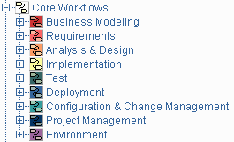
Workflow Details

Slide 40
Business Modeling: Purpose
To understand the structure and the dynamics of the organization in which a system is to be deployed (the target organization).
To understand current problems in the target organization and identify improvement potentials.
To ensure that customers, end users, and developers have a common understanding of the target organization.
To derive the system requirements needed to support the target organization.

Slide 41
How achieve goals?
To achieve these goals, the business modeling workflow describes how to develop a vision of the new target organization, and based on this vision define the processes, roles, and responsibilities of that organization in a business use-case model and a business object model.
Complementary to these models, the following artifacts are developed:
  Supplementary Business Specification
  Glossary

Slide 42
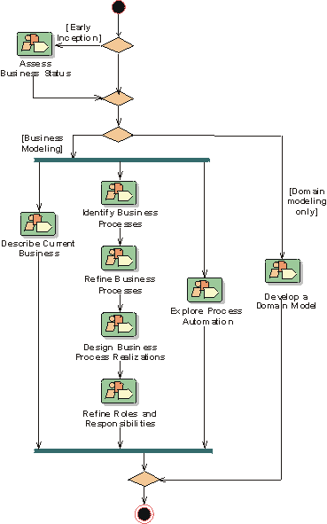
Business Modeling: Overview

Slide 43
Requirements : Purpose
To establish and maintain agreement with the customers and other stakeholders on what the system should do
To provide system developers with a better understanding of the system requirements.
To define the boundaries of (delimit) the system.
To provide a basis for planning the technical contents of iterations.
To provide a basis for estimating cost and time to develop the system.
To define a user-interface for the system, focusing on the needs and goals of the users.

Slide 44
To Achieve These Goals
It is important, first of all, to understand the definition and scope of the problem which we are trying to solve with this system. The Business Rules, Business Use-Case Model and Business Object Model developed during Business Modeling will serve as valuable input to this effort.
Stakeholders are identified and Stakeholder Requests are elicited, gathered and analyzed.
A Vision document, a use-case model, use cases and Supplementary Specification are developed to fully describe the system - what the system will do - in an effort that views all stakeholders, including customers and potential users, as important sources of information (in addition to system requirements).
Stakeholder Requests are both actively elicited and gathered from existing sources to get a "wish list" of what different stakeholders of the project (customers, users, product champions) expect or desire the system to include, together with information on how each request has been considered by the project.

Slide 45
Requirement-Artifacts
Vision
use-case model
Supplementary Specifications
Software Requirements Specification (SRS)
Complementary to the above mentioned artifacts, the following artifacts are also developed:
Glossary
Use-Case Storyboard
User-Interface Prototype

Slide 46
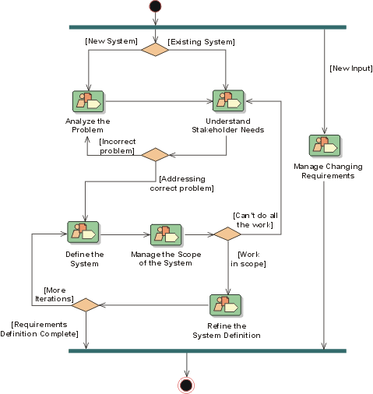
Requirements: Overview

Slide 47
The purposes of Analysis & Design
To transform the requirements into a design of the system to-be.
To evolve a robust architecture for the system.
To adapt the design to match the implementation environment, designing it for performance.

Slide 48
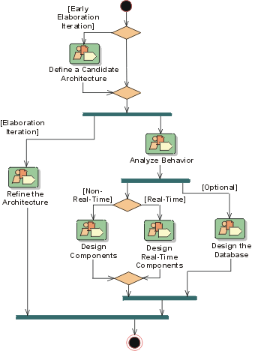
Analysis & Design: Overview

Slide 49
The purpose of implementation
To define the organization of the code, in terms of implementation subsystems organized in layers,
To implement classes and objects in terms of components (source files, binaries, executables, and others),
To test the developed components as units, and
To integrate the results produced by individual implementers (or teams), into an executable system.
The Implementation workflow limits its scope to how individual classes are to be unit tested. System test and integration test are described in the Test workflow.

Slide 50
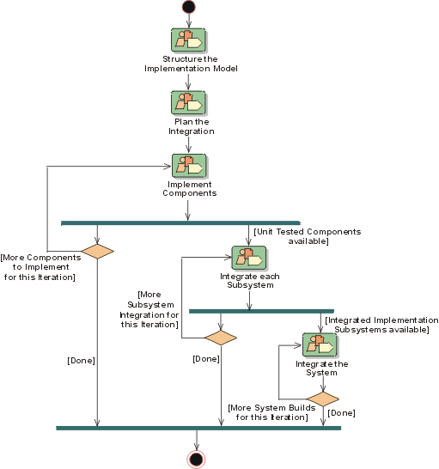
Implementation: Overview

Slide 51
The purposes of testing
To verify the interaction between objects.
To verify the proper integration of all components of the software.
To verify that all requirements have been correctly implemented.
To identify and ensure defects are addressed prior to the deployment of the software.

Slide 52
Testing With No methodology
In many organizations, software testing accounts for 30 to 50 percent of software development costs. Yet most people believe that software is not well tested before it is delivered. This contradiction is rooted in two clear facts.
  First, testing software is enormously difficult. The different ways a given program can behave are unquantifiable.
  Second, testing is typically done without a clear methodology and without the required automation or tool support. While the complexity of software makes complete testing an impossible goal, a well-conceived methodology and use of state-of-the-art tools, can greatly improve the productivity and effectiveness of the software testing.
For "safety-critical" systems where a failure can harm people (such as air-traffic control, missile guidance, or medical delivery systems), high-quality software is essential for the success of the system produced. For a typical MIS system, this situation is not as painfully obvious, but the impact of a defect can be very expensive

Slide 53
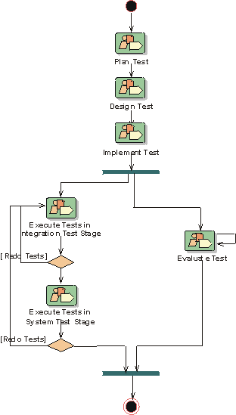
Test: Overview

Slide 54
Deployment Purpose
The Deployment Workflow describes the activities associated with ensuring that the software product is available for its end users.
The Deployment Workflow describes three modes of product deployment:
  the custom install
  the "shrink wrap" product offering
  access to software over the internet

Slide 55
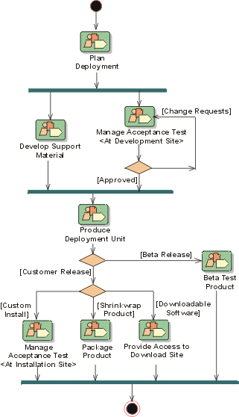
Deployment: Overview

Slide 56
Controlling the Artifacts
A CM System is essential for controlling the numerous artifacts produced by the many people who work on a common project. Control helps avoid costly confusion, and ensures that resultant artifacts are not in conflict due to some of the following kinds of problems:
Simultaneous Update
Limited Notification
Multiple Versions

Slide 57
Artifact Under Changes
Simultaneous Update
When two or more workers work separately on the same artifact, the last one to make changes destroys the work of the former. The basic problem is that if a system does not support simultaneous update this leads to serial changes and slows down the development process. However, with simultaneous update, the challenge is to detect that updates have occurred simultaneously and to resolve any integration issues when these changes are incorporated
Limited Notification
When a problem is fixed in artifacts shared by several developers, and some of them are not notified of the change.
Multiple Versions
Most large programs are developed in evolutionary releases. One release could be in customer use, while another is in test, and the third is still in development. If problems are found in any one of the versions, fixes need to be propagated between them. Confusion can arise leading to costly fixes and re-work unless changes are carefully controlled and monitore

Slide 58
CM and CRM
Configuration and Change Request Management (CM and CRM) involves:
identifying configuration items,
restricting changes to those items,
auditing changes made to those items, and
defining and managing configurations of those items.

Slide 59
CM System is an Essential
The methods, processes, and tools used to provide change and configuration management for an organization can be considered as the organization’s CM System.
An organization's Configuration and Change Request Management System (CM System) holds key information about its product development, promotion, deployment and maintenance processes, and retains the asset base of potentially re-usable artifacts resulting from the execution of these processes.
The CM System is an essential and integral part of the overall development processes

Slide 60
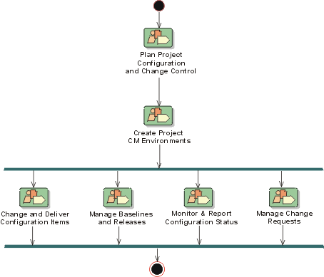
Configuration & Change Management: Overview

Slide 61
Project Management
Software Project Management is the art of balancing competing objectives, managing risk, and overcoming constraints to successfully deliver a product which meets the needs of both customers (the payers of bills) and the users.
The fact that so few projects are unarguably successful is comment enough on the difficulty of the task.

Slide 62
The purpose of Project Management
To provide a framework for managing software-intensive projects.
To provide practical guidelines for planning, staffing, executing, and monitoring projects.
To provide a framework for managing risk.

Slide 63
RUP doesn’t Cover
Managing people: hiring, training, coaching
Managing budget: defining, allocating, etc.
Managing contracts, with suppliers and customers

Slide 64
Work Flows
The Project Management workflow focuses mainly on the important aspects of an iterative development process:
Risk management
Planning an iterative project, through the lifecycle and for a particular iteration
Monitoring progress of an iterative project, metrics

Slide 65
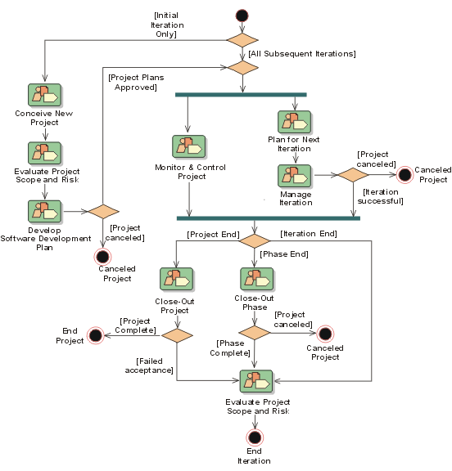
Project Management: Overview

Slide 66
The environment workflow
Focuses on the activities necessary to configure the process for a project.
It describes the activities required to develop the guidelines in support of a project.
The purpose of the environment activities is to provide the software development organization with the software development environment - both processes and tools - that will support the development team.

Slide 67
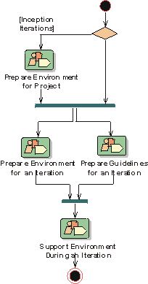
Environment: Overview

Slide 68
Worker Sets
Analyst workers
Developer workers
Testing professional workers
Manager workers
Other workers

Slide 69
Analyst Worker Set
The Analyst worker set organizes workers primarily involved in the elicitation and investigation of requirements.
Business-Process Analyst
Business Designer
Business-Model Reviewer
Requirements Reviewer
System Analyst
Use-Case Specifier
User-Interface Designer

Slide 70
Developer Worker Set
The Developer worker set organizes workers primarily involved in the design and development of the software.
Architect
Architecture Reviewer
Capsule Designer
Code Reviewer
Database Designer
Design Reviewer
Designer
Implementer
Integrator

Slide 71
Testers Worker Set
The Testing Professionals worker set organizes workers primarily involved in testing the software.
Test Designer
Tester

Slide 72
Manager Worker Set
The Manager worker set organizes workers primarily involved in management and configuration of the software engineering process.
Change Control Manager
Configuration Manager
Deployment Manager
Process Engineer
Project Manager
Project Reviewer

Slide 73
Additional Worker Set
The additional worker set organizes workers involved in support or miscellaneous roles on the project.
Any Worker
Course Developer
Graphic Artist
Stakeholder
System Administrator
Technical Writer
Tool Specialist

Slide 74
Question And Answers

